Slide 1
System Level Programming
Software College of SCU
四川大学软件学院 左航
Email: hangz2007@hotmail.com
Course website: http://swjx.scu.edu.cn/moodle/

Slide 2
Review(1/3)
PUSH & POP
SP 指向当前栈顶最后压入的一个字节
PUSH EAX (32bits)
    假设压栈前SP = 0x0012ff40，则PUSH执行后，
    1. 0x0012ff3c~3f将用于存放EAX的值，
    2. SP=SP-4,即SP修改为 0x0012ff3c
POP AX (16bits)
    假设压栈前SP = 0x0012ff40，则POP执行后，
    1. 0x0012ff40~41的值拷贝入AX
    2. SP=SP+2,即SP修改为 0x0012ff42
    Tips: SP的修改意味着以前数据理论上不能访问了，但是该字节的内容并没有被擦除。
201001V1.1

Slide 3
Review(2/3)
栈底： 高地址
0X0012FF43: 03
0X0012FF42: 02
0X0012FF41: 01
0X0012FF40: 01
MOV EAX,5
PUSH EAX
SP
0X0012FF3F: 00
0X0012FF3E: 00
0X0012FF3D: 00
0X0012FF3C: 05
201001V1.1

Slide 4
Review(3/3)
CALL & RET
  CALL (导致ESP 修改-4/-8)
    1. PUSH IP( a near or short call)/PUSH CS PUSH IP (far call)
    2. JMP 跳转至被调用函数
  RET (导致ESP 修改+4)
    POP IP
  RETF(导致ESP 修改+8,对应far call)
    POP IP POP CS
201001V1.1
Notes:
短和近转移是同一个代码段内转移，根据具体的IP变化范围划分；
远转移是不同代码段间转移（比如多个汇编程序链接在一起，一个文件调用另一个文件的代码段）

Slide 5
Unit 5. Function Call and Return
5.0 Introduction
5.1 Implementation of Parameter and Local Variables
5.2 Activation Record and Stack Frame
5.3 Function Calling Conventions
201001V1.1

Slide 6
Unit 5. Function Call and Return
5.0 Introduction
5.1 Implementation of Parameter and Local Variables
5.2 Activation Record and Stack Frame
5.3 Function Calling Conventions
201001V1.1

Slide 7
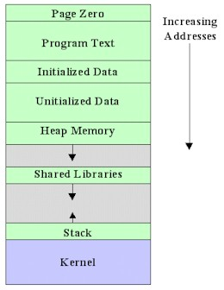
5.0 Introduction(1/1)
Conclusion
  local variables
  Function calls
    actual parameters
    return value
    return address
Map
201001V1.1

Slide 8
Unit 5. Function Call and Return
5.0 Introduction
5.1 Implementation of Parameter and Local Variables
5.2 Activation Record and Stack Frame
5.3 Function Calling Conventions
201001V1.1

Slide 9
5.1 Implementation of Parameter and Local Variables
5.1.1 Local Variables & Parameters/ Argument
5.1.2 How the compiler implement them
201001V1.1

Slide 10
5.1.1 Local Variables(1/10)
Scope:
  Variables have scopes, that is, a variable name may refer to different values depending on where it is used
    这句话是指当多个同名变量同时存在时，由作用域指定哪个被激活
Example
  Local variable is private to the block where it is defined.
  Global variable can be accessed by others.
201001V1.1

Slide 11
5.1.1 Local Variables(2/10)
Example Scope.c
#include <stdio.h>
int first;
int second;
void callee ( int first ) {
int second;
second = 1;
first = 2;
printf("callee: first = %d second = %d\n", first, second);
}
int main (int argc, char *argv[]) {
int mainlocal = 0;
first = 1;
second = 2;
callee(first);
printf("caller: first = %d second = %d\n", first, second);
return 0;
}
Same variable “second”, but different memory location
201001V1.1

Slide 12
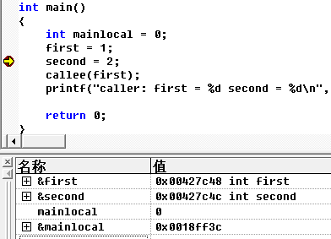
5.1.1 Local Variables(3/10)
Address of first is 0x00427c48 in main()
mainlocal is valid
201001V1.1

Slide 13
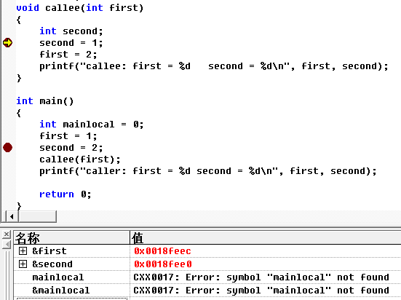
5.1.1 Local Variables(4/10)
Address of first is 0x0018feec in callee()
传值
mainlocal is invalid
201001V1.1

Slide 14
5.1.1 Local Variables(10/10)
#include <stdio.h>
void callee ( int * first ) //not a variable, but an address
{
int second;
second = 1;
*first = 2;
printf("callee: first = %d second = %d\n", *first, second);
}
int main (int argc, char *argv[])
{
int first = 1;
int second = 2;
callee(&first); //passed by address ---
printf("caller: first = %d second = %d\n", first, second);
return 0;
}
Content by address
callee: first = 2 second = 1
caller: first = 2 second = 2
201001V1.1

Slide 15
5.1.1 Local Variables(6/10)
Notice:
  For a formal parameter （形参） to a function, the compiler assigns an address for the scope of the callee - just as if it were declared locally. 编译器按被调用函数的局部变量来处理形参
Conclusion:
  The compiler implements them both by assigning an address that is different from the addresses of global variables and actual parameters （实参）. 形参地址因此不同于全局和主调函数实参
Result:
  This allows the actual parameter to remain unperturbed（不被打扰的） by any assignment made to the formal parameter in the callee.
How to realize ?
201001V1.1

Slide 16
5.1.1 Local Variables(7/10)
How compiler implements scopes
  Compilers implement scoping by manipulating different memory addresses from within different scopes.
  Variables having the same name are mapped to different addresses by the compiler.
  The hardware does not know about scoping.
201001V1.1

Slide 17
5.1 Implementation of Parameter and Local Variables
5.1.2 How the compiler implement them
201001V1.1

Slide 18
5.1.2 How the compiler implement them(1/7)
What we have seen:
  local and global variables seem to be allocated in very different address ranges,
  globals are near other globals, and locals near other locals.
Local variables in different functions, are they near each other?
Examine recursive function calls to figure out the answer . See example Recurse.cpp
201001V1.1

Slide 19
5.1.2 How the compiler implement them(2/7)
Recursion迭代函数
Calling itself, say
    callee (n) {
    if (n == 0) return;
    printf(“……”);
    callee(n-1);
    }
It will create local variable (n) for each call
201001V1.1

Slide 20
5.1.2 How the compiler implement them(3/7)
10 (0x0065fda4)
9 (0x0065fd4c)
8 (0x0065fcf4)
7 (0x0065fc9c)
6 (0x0065fc44)
5 (0x0065fbec)
4 (0x0065fb94)
3 (0x0065fb3c)
2 (0x0065fae4)
1 (0x0065fa8c)
1 (0x0065fa8c)
2 (0x0065fae4)
3 (0x0065fb3c)
4 (0x0065fb94)
5 (0x0065fbec)
6 (0x0065fc44)
7 (0x0065fc9c)
8 (0x0065fcf4)
9 (0x0065fd4c)
10 (0x0065fda4)
#include <stdio.h>
#include <stdlib.h>
void callee (int n) {
if (n == 0) return;
printf("%d (0x%08x)\n", n, &n);
callee (n - 1);
printf("%d (0x%08x)\n", n, &n);
}
int main (int argc, char * argv[]) {
int n;
if (argc < 2) {
printf("USAGE: %s \n", argv[0]);
return 1;
}
n = atoi(argv[1]);
callee(n);
return 0;
} //address distance = 0x58
201001V1.1

Slide 21
5.1.2 How the compiler implement them(4/7)
void callee (10 ) {
callee(9)….
}
void callee (9 ) {
callee(8)….
}
void callee (8 ) {
callee(7)….
}
void callee (7 ) {
callee(6)….
}
void callee (6 ) {
callee(5)….
}
void callee (5 ) {
callee(4)….
}
……
void callee (0 ) {
return;
}
201001V1.1

Slide 22
5.1.2 How the compiler implement them(5/7)
A Problem: 矛盾
  Since: functions can be called recursively, and each recursive invocation needs its own instantiation of local variables(即时版本的变量)
  Then: The compiler would not be able to decide how many to allocate until after the program was already running.
  But if the program is running, the compiler has already finished its work!
201001V1.1

Slide 23
5.1.2 How the compiler implement them(6/7)
Answer (important)
  Global variables can be allocated statically.
    This means that the compiler can fix specific addresses for global variables before the program executes.
  Compilers must allocate local variables dynamically because
    Because the compiler does not know how many variables it will need to allocate dynamically, it reserves a lot of space for expansion.
      This is why the local variables are allocated to addresses that are very far away from the addresses that hold the global variables.
201001V1.1

Slide 24
5.1.2 How the compiler implement them(7/7)
Conclusion
  actual parameters and local variables need to be allocated dynamically
  But where and how?
    Activation Record and Stack Frame
      ebp & esp
201001V1.1

Slide 25
Unit 5. Function Call and Return
5.0 Introduction
5.1 Implementation of Parameter and Local Variables
5.2 Activation Record and Stack Frame
5.3 Function Calling Conventions
201001V1.1

Slide 26
5.2 Activation Record and Stack Frame
5.2.1 Basic of Activation Record and Stack Frame
5.2.2 The process of call/ret
  The elements of Stack Frame
  Caller/Callee and Stack Frame
201001V1.1

Slide 27
5.2 Activation Record and Stack Frame
5.2.1 Basic of Activation Record and Stack Frame
5.2.2 The process of call/ret
  The elements of Stack Frame
  Caller/Callee and Stack Frame
201001V1.1

Slide 28
5.2.1 Basic of Activation Record and Stack Frame(1/5)
Local variable and actual parameters：
  dynamically allocated
  slow down the program’s execution
Compiler的具体实现方法：
  To minimize the cost, the compiler calculates the amount of total space required for the function's locals and allocates that space in one single chunk
    类比：a travel agent ＋request a single chunk of seats from the airline
201001V1.1

Slide 29
5.2.1 Basic of Activation Record and Stack Frame(2/5)
Hardware support硬件的支持：
  the compiler and hardware internally maintain two important values that serve to delimit and manipulate the activation records in a simple yet elegant manner
    stack pointer R --esp
    frame pointer R --ebp
  activation records be organized in very simple manner to fit the hardware足够简单以适应硬件
201001V1.1

Slide 30

5.2.1 Basic of Activation Record and Stack Frame(3/5)
ebp 栈底
Diagram - stack push (page20递归调用 为例子)
main‘s stack frame
callee(2)’s stack frame
callee(1)’s stack frame
callee(0)’s stack frame
High address
main ebp
esp 栈顶
Stack Frame growth
callee(2)’s ebp
callee(1)’s ebp
Low address
callee(0)’s ebp? 不要
201001V1.1

Slide 31
5.2.1 Basic of Activation Record and Stack Frame(4/5)
Rule：Only the activation record at the top of the stack (or simply TOS) can be accessed
Is this Rule OK? : YES
  控制权：A function never returns before all of its active subroutines return 只有当该函数调用的所有子函数返回，该函数才可能返回。
  变量的scope：we never need to access data from an activation record that is not at the top of the stack
    我们只能访问当前正在执行的函数的局部变量（和全局变量—不在stack上）。
201001V1.1

Slide 32
5.2.1 Basic of Activation Record and Stack Frame(5/5)
定义：Activation Record/Stack Frame：The chunk of memory allocated for each function invocation激活
  Activation records are organized in a stack , they are also called stack frames.
生命期：function call/function return
201001V1.1

Slide 33
5.2 Activation Record and Stack Frame
5.2.1 Basic of Activation Record and Stack Frame
5.2.2 The process of call/ret
  The elements of Stack Frame
  Caller/Callee and Stack Frame
201001V1.1

Slide 34
5.2.2 The process of call/ret(1/15)
When a function is called, the compiler and hardware:
caller ：save context
  push parameters and the return address into the stack
callee: construct own Stack Frame
  push the frame pointer into the stack
  set the frame pointer equal to the stack pointer
  Allocate a chunk of memory to store the local state by decrement the stack pointer with an uncertain integer
Estimated by compiler according to the function content
201001V1.1

Slide 35
5.2.2 The process of call/ret(2/15)
1. Function Call
  Caller Responsibilities发起调用者
    Save caller registers (if necessary)
      eax, ecx, edx
    Arguments (push)
      Pushed onto stack
      In what order?
    Execute the call instruction
      Pushes return address (that of the next instruction) onto the stack
caller
Arguments
Return Addr
Old ebp
Local
Variables
saved
register
…Arguments
201001V1.1

Slide 36
5.2.2 The process of call/ret(3/15)
1. Function Call
  Callee Responsibilities被调用者
    Save base pointer on stack
      push ebp
    Set base pointer to point to the top of the stack
      mov ebp,esp
    Allocate space for local variables
      Decrement the stack pointer
      sub esp,44h(uncertain)
    Save callee’s registers
      push ebx
      push esi
      push edi
Arguments
Return Addr
Old ebp
Local
Variables
callee
saved
register
…Arguments
201001V1.1

Slide 37
5.2.2 The process of call/ret(4/15)
Analyze Code
#include <stdio.h>
void myfunction(int a, int b)//callee
{
int c=a+b;
}
void main()
{
int y=6,x=5;
myfunction(x,y);//caller
}
201001V1.1

Slide 38
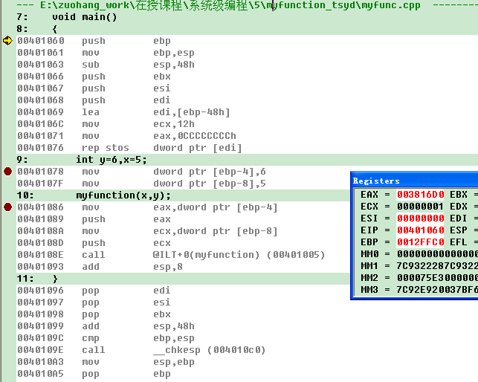
Arguments
y
x
Address of jmp
Return address
201001V1.1

Slide 39
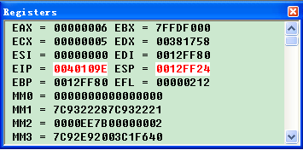
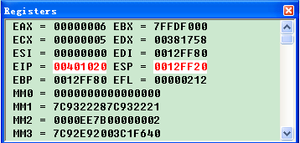
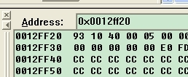
Call 执行前
004010E8
Return address
Call 执行后，jump执行前
00401005
201001V1.1

Slide 40
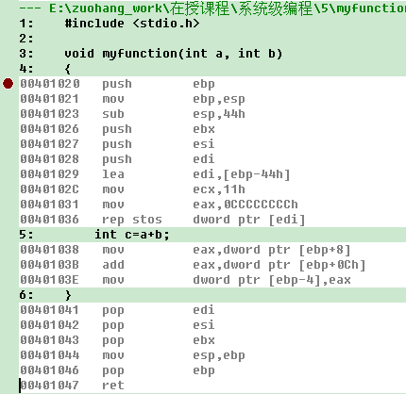
5.2.2 The process of call/ret(7/15)
201001V1.1

Slide 41
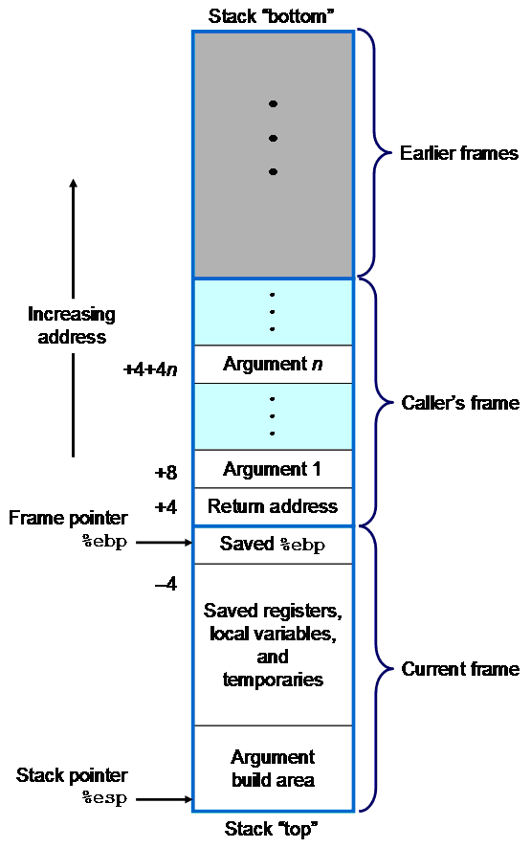
5.2.2 The process of call/ret(8/15)
Stack Frame growth
generated by caller
偏移为正
偏移为负
generated by callee
201001V1.1

Slide 42
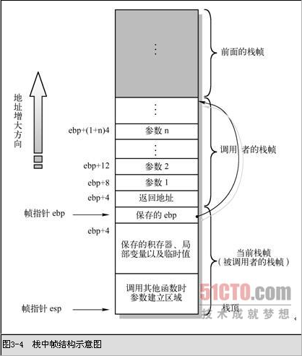
5.2.2 The process of call/ret(9/15)
发出调用的函数
偏移为正
Stack Frame growth
ebp-4
偏移为负
被调用函数
201001V1.1

Slide 43
5.2.2 The process of call/ret(10/15)
Get return address
201001V1.1

Slide 44
5.2.2 The process of call/ret(11/15)
Y
X
return address
ebp
main‘s ebp
c
201001V1.1

Slide 45
5.2.2 The process of call/ret(12/15)
2. Function Call Return
  Callee Responsibilities被调用函数
1.Move return value into eax
2.mov esp,ebp %Restore stack pointer
Arguments
Return Addr
Old ebp
3. pop ebp %Restore the base pointer to value for calling functionp
Local
Variables
EBP
4.ret %Pops return address and jump
Saved
Registers
ESP
Argument
Build
201001V1.1
Notes:
只有一个eax，只有一个返回值

Slide 46
myfunction函数返回时的工作
Delete formal parameters X and Y, 8bytes
main函数返回时的工作
201001V1.1

Slide 47
5.2.2 The process of call/ret(14/15)
2. Function Call Return
  Caller Responsibilities
    Pop the arguments by increment the stack pointer for arguments
      add esp,8
        Two INT arguments
      add esp,n ；n由全部实参占用空间确定
Arguments
ESP
Return Addr
Old ebp
Local
Variables
Saved
Registers
Argument
Build
201001V1.1

Slide 48
5.2.2 The process of call/ret(15/15)
Debug a recursive function by yourself
Verify how the stack frame is created and deleted
201001V1.1

Slide 49
Unit 5. Function Call and Return
5.0 Introduction
5.1 Implementation of Parameter and Local Variables
5.2 Activation Record and Stack Frame
5.3 Function Calling Conventions规则
201001V1.1

Slide 50
5.3 Function Calling Conventions(1/6）
Why calling conventions?
  Function call in C level
    Parameters
    Local variables
    Return value
  Function call in Assembly/Machine level
    call and ret instruction
201001V1.1

Slide 51
5.3 Function Calling Conventions(2/6）
What calling conventions? -Calling conventions describe the interface of called code:
  The order in which parameters are allocated
  Where parameters are placed (pushed on the stack or placed in registers)
  Which registers may be used by the function
    eax for return value
  Whether the caller or the callee is responsible for unwinding(解开) the stack on return
201001V1.1

Slide 52
5.3 Function Calling Conventions(3/6）
calling conventions Types
  _cdecl/C Declaration表示C语言默认的函数调用方法
  _stdcall / WINAPI
  Pascal
  _fastcall
  _thiscall
201001V1.1

Slide 53
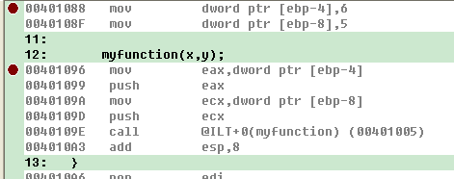
5.3 Function Calling Conventions(4/6）
_cdecl
  Parameters are pushed into stack by the order of “from right to left”
  It is the caller’s Responsibility to clean parameters on the stack
201001V1.1
Notes:
__cdecl 是C Declaration的缩写（declaration，声明），表示C语言默认的函数调用方法：所有参数从右到左依次入栈，这些参数由调用者清除，称为手动清栈。被调用函数不会要求调用者传递多少参数，调用者传递过多或者过少的参数，甚至完全不同的参数都不会产生编译阶段的错误。

Slide 54
5.3 Function Calling Conventions(5/6)
_stdcall
  Parameters are pushed into stack by the order of “from right to left”
  It is the callee’s Responsibility to clean parameters on the stack
Pascal
  Parameters are pushed into stack by the order of “from left to right”
  It is the callee’s Responsibility to clean parameters on the stack
201001V1.1

Slide 55
5.3 Function Calling Conventions(6/6)
Extending Reading Reference
  http://book.51cto.com/art/200812/103116.htm：赵炯的Book的 “3.4.1 C函数调用机制” （GAS风格）
  《天书夜读》的Chap1 谭文 邵坚磊著 电子工业出版社（MASM风格）
  http://baike.baidu.com/view/1280676.htm： _cdecl等的解释
201001V1.1

Slide 56
Dynamic illustration about memory layout
201001V1.1

Slide 57
6.1.5 Program Memory Layout(1/1)
address zero is reserved and made unreadable to catch the common bug of trying to use a NULL pointer to access data
Machine code instruction
dynamically linked shared libraries
in some systems, the operating system or operating system kernel becomes part of an application's memory during system calls.
201001V1.1

Slide 58
Dynamic illustration about memory layout
Machine code executed by cpu is stored in memory location named Program Text (read only,static)
When these code is executing, data in stack (dynamic) changed as the code required.
201001V1.1

Slide 59
由于vs 2010后，disassembly 窗口显示的汇编格式有一定变化，为了较好的观察 stack frame及完成实验，推荐安装vc6.0
见本次实验bufbomb安装包
201001V1.1

Slide 60
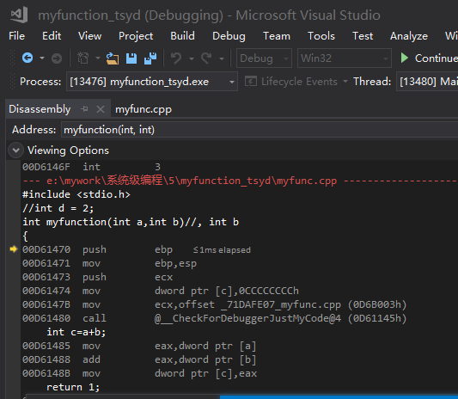
#include <stdio.h>
void myfunction(int a, int b)
{
int c=a+b;
}
void main()
{
int y=6,x=5;
myfunction(x,y);
}
201001V1.1

Slide 61
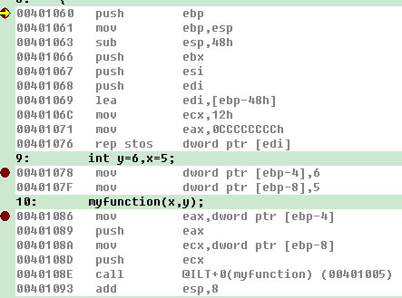
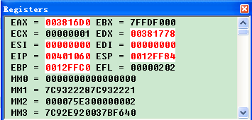
_cdecl：It is the caller’s Responsibility to clean parameters on the stack
201001V1.1

Slide 62
0x12ff24
0x12ff28
0x12ff2c
0x12ff30
0x12ff34
0x12ff38
0x12ff78
0x12ff7c
0x12ff80
Return addr
Sp=0x12ff24
ecx=5 形参
call
eax=6形参
Push ecx
edi
Push eax
esi
mov dword~[ebp-8],5
ebx
mov dword~[ebp-4],6
Sp=sp-48h
0xcccccccc
Lea~rep
0xcccccccc
Push edi
0xcccccccc
Push esi
0xcccccccc
Push ebx
5
0xcccccccc
Sub esp,48h
0xcccccccc
6
Mov ebp,esp
Ebp2=0x12ff80
Ebp2=0x12ff80
0x12ffc0 ebp1
push ebp
sp
地址
值
指令
mov dword~[ebp-8],5

Slide 64
0x12ff1c
0x12ff20
0x12ff24
0x12ff28
0x12ff2c
0x12ff30
0x12ff34
0x12ff38
0x12ff78
0x12ff7c
0x12ff80
Return addr
0x401093
sp
Ebp2=0x12ff80
Mov ebp,esp
Ebp3=0x12ff1c
Push ebp
Sp=0x12ff24
ecx=5 形参
call
eax=6形参
Push ecx
edi
Push eax
esi
mov dword~[ebp-8],5
ebx
mov dword~[ebp-4],6
Sp=sp-48h
0xcccccccc
Lea~rep
0xcccccccc
Push edi
0xcccccccc
Push esi
0xcccccccc
Push ebx
5
0xcccccccc
Sub esp,48h
0xcccccccc
6
Mov ebp,esp
Ebp2=0x12ff80
Ebp2=0x12ff80
0x12ffc0 ebp1
push ebp
地址
值
指令
mov dword~[ebp-8],5

Slide 65
Sub esp,48h
48h is related to the local variable need to allocate memory in stack , not heap.
Add “int *q = new int[10];” in main function only change 48h into 50h
Add “int q[10];” in main function change 48h into 70h
  70h-48h=28h=40d=4*10

Slide 66
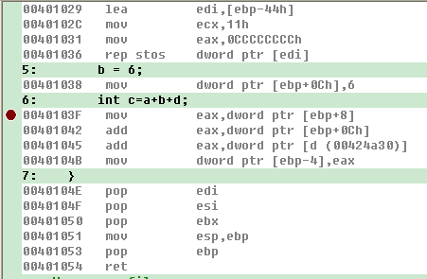
return

Slide 67
地址
0x12fecc
0x12fed0
0x12fed4
0x12fed8
0x12ff14
0x12ff18
0x12ff1c
0x12ff20
0x12ff24
Ebp2=0x12ff80
ret—pop return addr
pop ebp
Mov esp,ebp
Sp=0x12ff24
Pob ebx
edi
pop esi
esi
pop edi
指令
ebx
…add…
Sp=sp-44h
0xcccccccc
Lea~rep
0xcccccccc
Push edi
0xcccccccc
Push esi
0xcccccccc
Push ebx
0xcccccccc
Sub esp,44h
c=a+b
Mov ebp,esp
Ebp3=0x12ff1c
push ebp
Sp
Return 0x401093

Slide 68
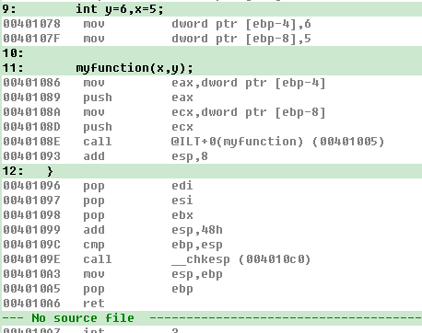

Slide 69
0x12ff1c
0x12ff20
0x12ff24
0x12ff28
0x12ff2c
0x12ff30
0x12ff34
0x12ff38
0x12ff78
0x12ff7c
0x12ff80
Return addr
0x401093
sp
ecx=5 形参
Sp=0x12ff24
eax=6形参
Sp=Sp+8
edi
esi
ebx
pop ebp
Sp=sp+12
0xcccccccc
…
0xcccccccc
Add esp,48h
0xcccccccc
pop ebx
0xcccccccc
pop esi
5
pop edi
0xcccccccc
0xcccccccc
add esp,8
6
Sp=sp+48h=0x12ff80
0x12ffc0 ebp1
ret—pop return addr
地址
值
指令
sp=sp+4=0x12ff84

